Slide 1
Project Title: Traffic sign detection and classification in real time challenging environment

Slide 2
Agenda
Project Overview
Project Plan
Data management Plan

Slide 3
overview
The goal of this project is to use edge computing and deep learning to create an AI-powered system for detecting and classifying traffic signs. The goal is to develop a model that can reliably recognize and categorize traffic signs in real time, especially in the face of difficult circumstances including bad weather, occlusions, and inadequate lighting.
The system uses convolutional neural networks (CNNs) and object identification models such as Faster R-CNN or YOLO (You Only Look Once) to improve the safety of autonomous driving and help driver assistance systems (ADAS). In order to enable effective and low-latency processing for practical applications, the project additionally improves the model for edge devices.

Slide 4
Research Question
How can Traffic sign detection and classification based on deep learning be optimized for real-time performance under challenging environmental conditions on edge computing devices?

Slide 5
Background
Detecting and classifying traffic-signal in Real Time is crucial for autonomous driving
Problem statement
Challenging environment like fog, rain, darkness etc..

Slide 6
Project Plan
Project timeline: 27th January 2025 to 13th May 2025
Key Milestones
Literature Review
Data Collection and Pre-processing
Model Development and Optimization
Comparative Analysis
Document and Final Submission
Gantt Chart to be provided separately

Slide 7
Data management plan
Dataset: Public traffic sign datasets + real world images.
Data Collection: Images from Open Images, Roboflow and real-time captures.
Security & Storage: Cloud storage, regular backups and GitHub repository
Ethical Considerations: Compliance with AI fairness and GDPR

Slide 8
TASK | DESCRIPTION | START DATE | END TIME
Literature Review | Review the literature in-depth with an emphasis on deep learning and edge computing techniques for traffic-sign recognition and categorization. | 27/01/2025 | 29/01/2025
Data Acquisition | Gather and prepare data sets of traffic science from open images, roboflow universe and actual photos taken in various settings | 30/01/2025 | 02//02/2025
Data Analysis | Clean data for model training, visualize data distribution, and do exploratory data analysis (EDA). Determine any trends all discrepancies. | 03/02/2025 | 06/02/2025
PDM plan | Create a Project Development and Management(PDM) strategy that includes important milestones, risk assessment, and methodology. Send in for evaluation. | 07/02/2025 | 09/02/2025
Data Ethic quiz | To make sure data handling and Ai model creation adhere to ethical standards and laws, take and ethics compliance quiz. | 10/02/2025 | 19/02/2025
Regression Model Development | Use a base line regression model to classify traffic indicators initially. Adjust the hyper parameters to increase accuracy. | 20/02/2025 | 29/02/2025
Comparative Analysis | To find the best model for real-time traffic sign detection, compare various deep learning architectures (such as YOLO, Faster R-CNN, and SSD). | 01/03/2025 | 25/03/2025
Documentation | For the final project submission record the methods, data sets, model performance and system deployment specifics. | 26/03/2025 | 19/04/2025
Final Project Report Submission | Create a final project report and submit it with all the conclusions, assessments, and findings. | 19/02/2025 | 28/04/2025
Viva preparation | Review the project results, polish the presentations, and prepare for any questions that may come up during the final viva. | 29/04/2025 | 12/05/2025
Project Timeline

Slide 9
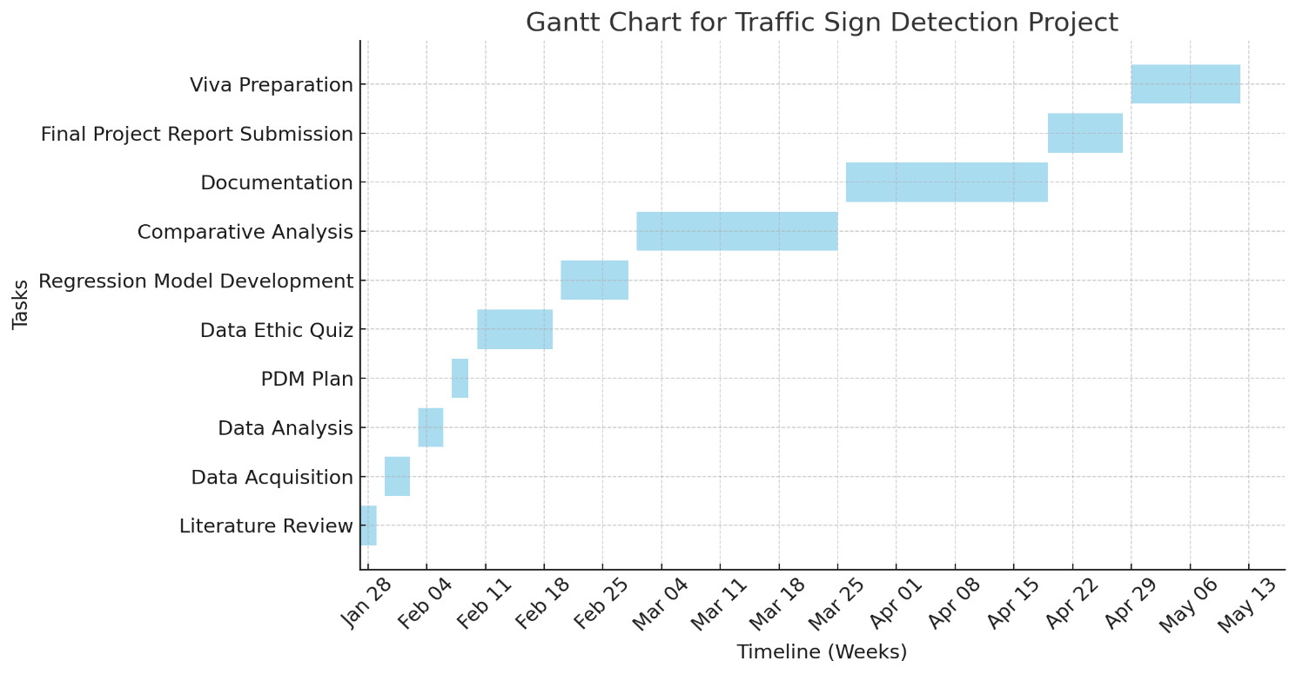
Gantt Chart

Slide 10
Challenges in Traffic sign detection
Real-time traffic sign detection still faces a number of difficulties: illumination Variations: Overexposure or inadequate illumination reduces detection accuracy. Weather: Snow, rain, and fog can make it difficult to see traffic signs. Occlusions & Motion Blur: Movement can cause signs to become partially obscured or blurred. Computational Restrictions: Quantization and pruning are two optimization strategies needed for deploying deep learning models on edge devices. Researchers suggest better network topologies, edge AI improvements, and data augmentation strategies to overcome these issues.

Slide 11
Conclusion
Deploy the core deep learning model into practice.
Evaluate and improve the model's performance under demanding settings.
Perform comparative analysis using various architectures.
Get ready for the viva and final submission.

